Slide 1
Deleterious Mutation Burden and its Association with Complex Traits in Sorghum
Ravi Valluru, Elodie E. Gazave, Samuel B. Fernandes, John Ferguson, Roberto Lozano, Pradeep, Tao Zuo, Patrick J. Brown, Andrew D.B. Leakey, Michael A. Gore, Edward S. Buckler, Nonoy Bandillo

Slide 2
Fig 1
(a)
(b)
Nonsynonymous deleterious mutations
Synonymous mutations
Figure 1 Deleterious mutations in the sorghum genome. (a) Site allele-frequency spectrum of nonsynonymous deleterious mutations and synonymous mutations in the sorghum genome. The Derived Allele Frequency (DAF) distribution of alleles is shown where a minor allele in the multi-species alignment was considered as a derived deleterious allele (Yang et al. 2017). (b) The allele frequency of the derived alleles in bins of different GERP scores. The vertical bars in (b) indicate standard error.

Slide 3
Fig 2
Deleterious Nondeleterious
Figure 2 Smoothed estimate of density distribution of regression coefficients associated with high conserved deleterious variants (HGERP_{DEL-SNPs}) and nondeleterious variants for ten phenotypic traits ((a) biomass, (b) specific leaf area (SLA), (c) tissue starch content (TSC), (d-j) plant height 4, 6, 8, 10, 12, 14, and 16 weeks after planting, respectively).

Slide 4
Fig 3
a
b
c
d
e
f
g
h
i
j
p < 2.2e-16
p = 0.47
p = 2.2e-16
p = 0.09
p = 0.00
p = 0.05
p = 0.21
p = 0.45
p = 2.4e-12
p = 1.0e-08
Figure 3 Barplots of means of folded distributions of effect sizes of high conserved deleterious variants (HGERP_{DEL-SNPs}) and nondeleterious variants for ten phenotypic traits ((a) biomass, (b) specific leaf area (SLA), (c) tissue starch content (TSC), (d-j) plant height 4, 6, 8, 10, 12, 14, and 16 weeks after planting, respectively). D: deleterious; ND: nondeleterious.

Slide 5
Fig 4
Figure 4 Homozygous mutation burden in sorghum. (a) Homozygous mutation burden estimated for different racial groups of sorghum based on high conserved deleterious variants (HGERP_{DEL-SNPs}). The derived allele is defined as a minor allele from multi-species sequence alignments (Yang et al. 2017). The mutation burden was estimated as the count of derived deleterious alleles carried by an individual divided by the total number of scored (non-missing) alleles. The horizontal broken line indicates the mean of homozygous mutation burden across all racial groups. (b) scatter plots of homozygous mutation burden and principal coordinate 1 derived from genome-wide SNP markers. The black circled point indicates the median values for each group.

Slide 6
Fig 5
Figure 5 Heritability estimates for all traits using a two-kernel model. Abbreviations: SLA, specific leaf area; TSC, tissue starch content; PH4 until PH16, plant height at 4, 6, 8, 10, 12, 14, and 16 weeks after planting (WAP), respectively.

Slide 7
Fig 6
Figure 6 Genome-wide prediction models incorporating putatively deleterious variants. (a-b) Heritability estimates for all traits using a single-kernel model. Heritability estimates for nondeleterious variants are derived based on 100 independent sets that are randomly chosen across the genome from variants that are not in LD with deleterious variants. (c-d) Boxplots showing a five-fold cross validation prediction ability estimation for deleterious variants and random variants.

Slide 8
Supplementary Information

Slide 9
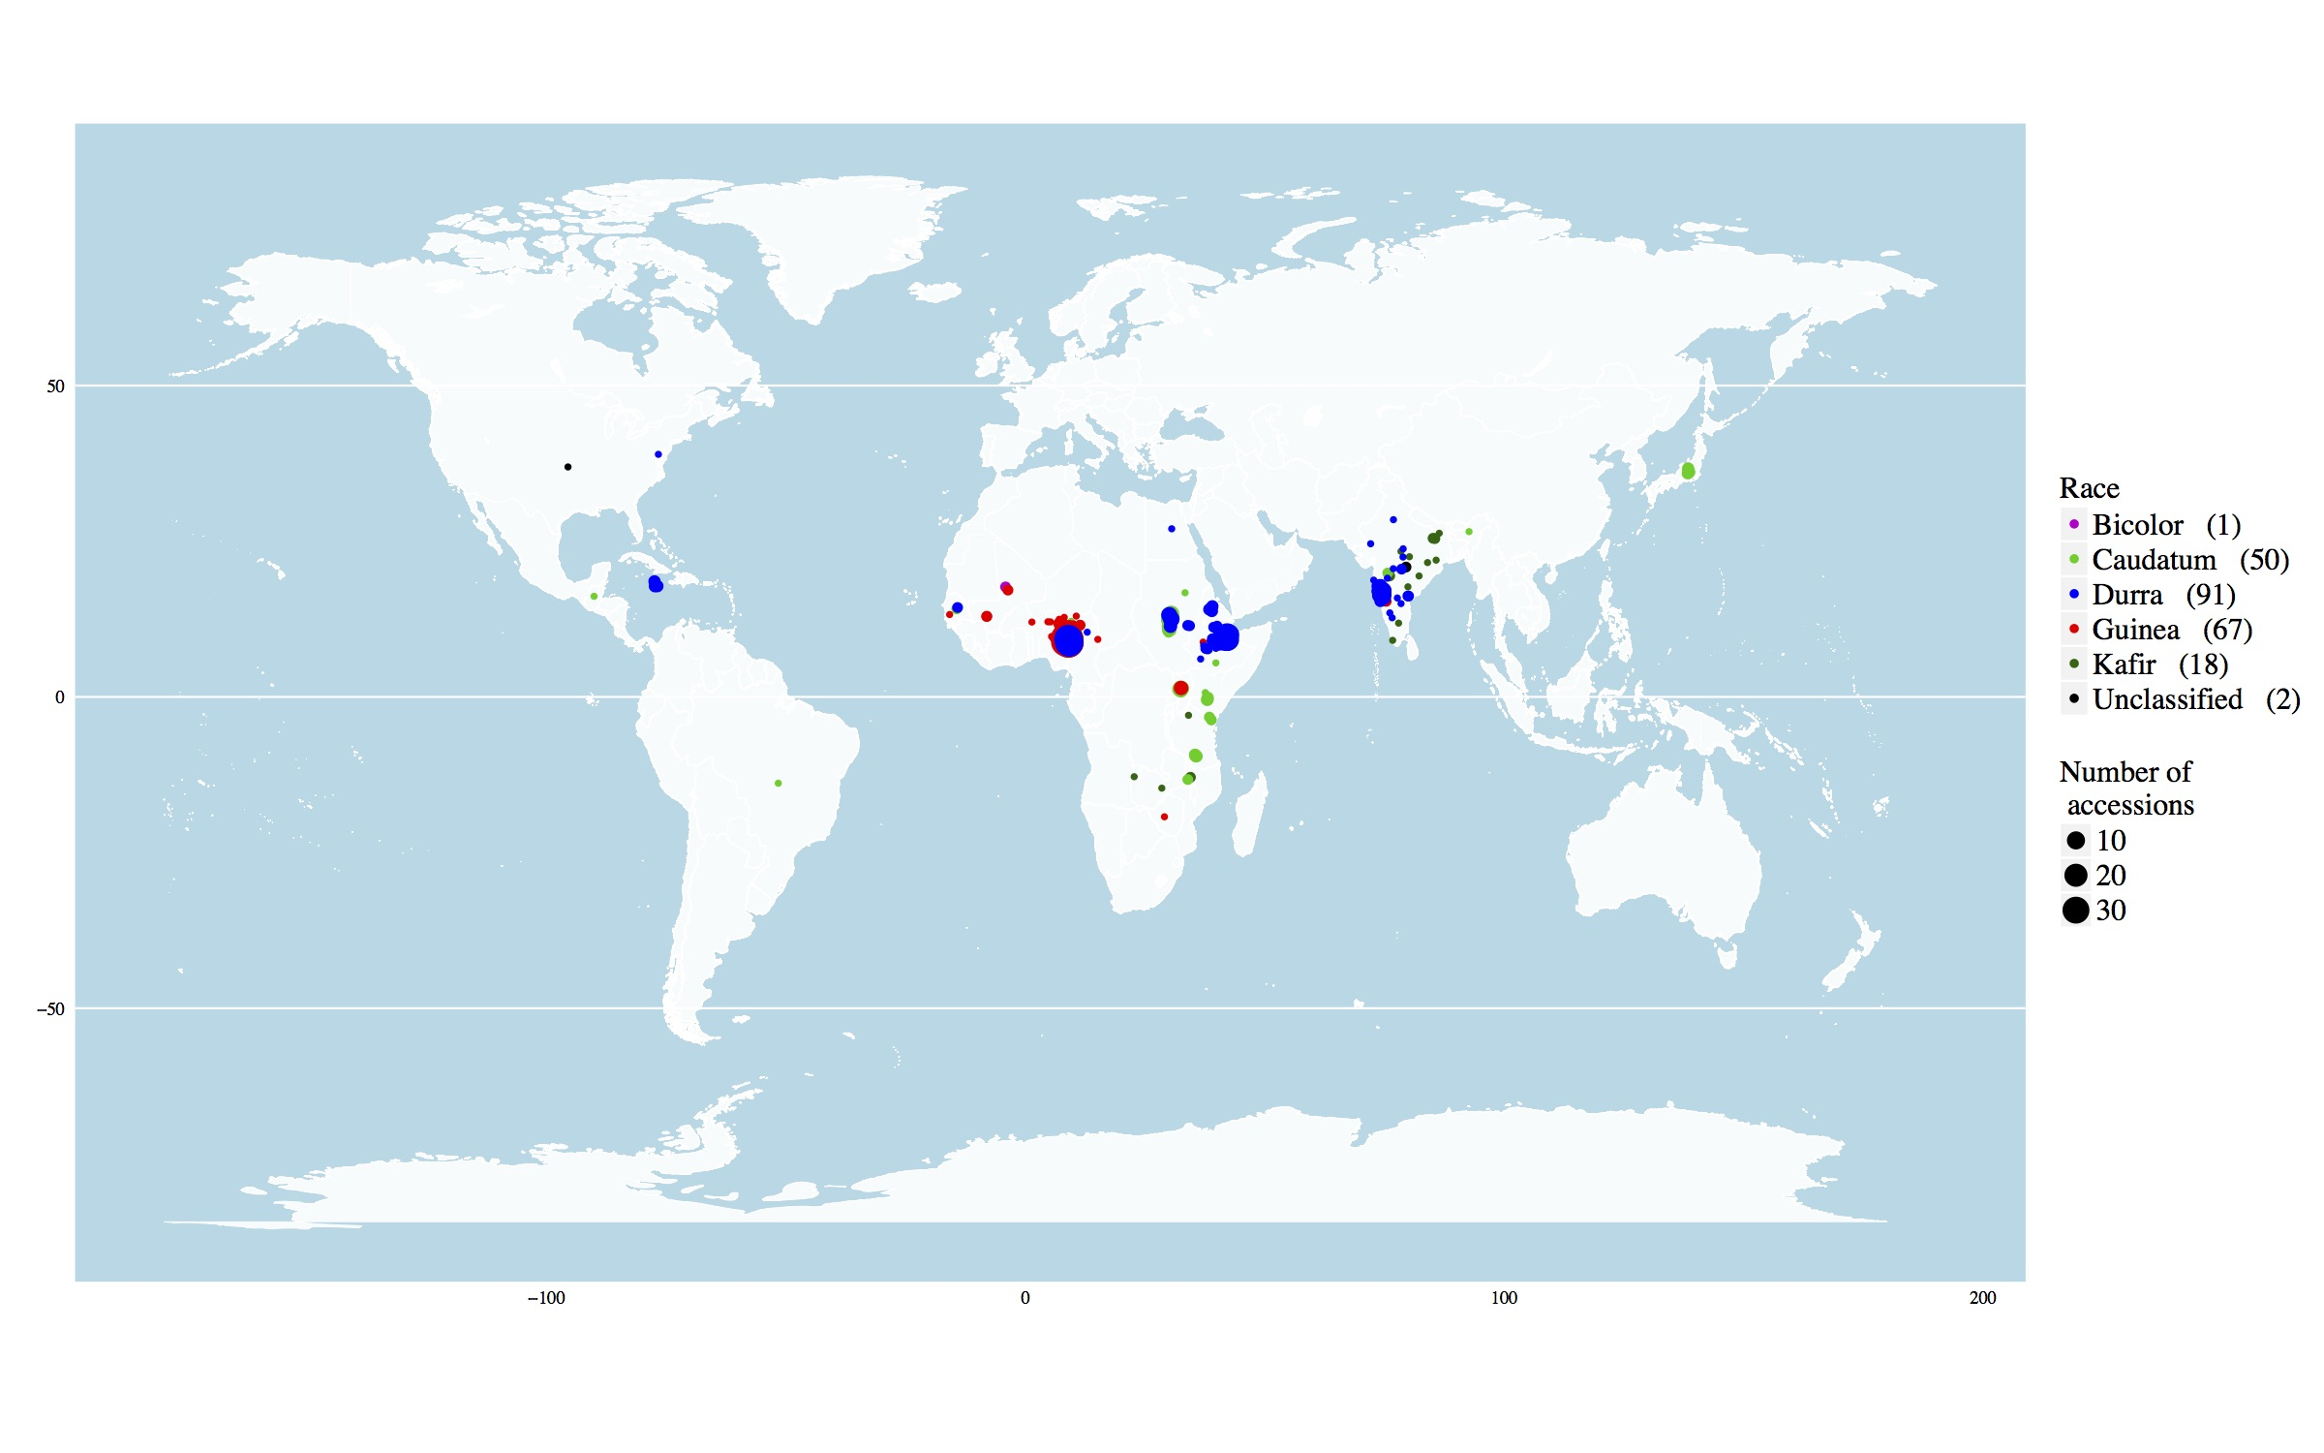
Fig. S1
Fig S1 The geographical distribution of diverse sorghum lines (229) used in the study.

Slide 10
Fig. S2
Mean LDscore (r²)
Fig S2 Mean linkage disequilibrium (LD) scores estimated for all chromosomes.

Slide 11
Fig. S3
r²
Fig S3 The number of single-nucleotide polymorphisms (SNPs) estimated under different parameters of window size and r².

Slide 12
Fig. S4
Fig S4 Allele frequency distribution comparison for high conserved deleterious variants (HGERP_{DEL-SNPs}, red) and nondeleterious variants (grey).

Slide 13
Fig. S5
Fig S5 Derived allele frequency (DAF) association with Sorting Intolerant From Tolerant (SIFT) scores, Derived allele was defined as a minor allele from a multi-species sequence alignments. SIFT was estimated using Vaser et al. (2016).

Slide 14
Fig. S6
a
b
c
d
Fig S6 Frequency distributions of highly conserved deleterious mutations (SIFT<0.05 and GERP>2). Sorting Intolerant From Tolerant (SIFT) distributions of (a) all deleterious mutations, (b) number of deleterious mutations estimated per coding regions in all chromosomes, (c) minor allele frequency distribution of deleterious mutations, and (d) GERP distributions of deleterious mutations.

Slide 15
Fig. S7
a
Chr. 1
Chr. 1
b
Chr. 5
Chr. 5
c
Chr. 8
Fig S7 Gene deleterious mutations distribution in chromosomes 1 (a), 5 (b), and 8 (c). The yellow color vertical bar indicates a centromeric regions showing absence of genes or deleterious mutations.

Slide 16
Fig S8
Fig S8 Empirical cumulative distributions (ECD) of the effect sizes for both high conserved deleterious variants (HGERP_{DEL-SNPs}) and nondeleterious variants for four phenotypic traits, biomass (a), specific leaf area (SLA, b), tissue starch content (TSC, c), and plant height 4 (d), 6 (e), 8 (f), 10 (g), 12 (h), 14 (i), and 16 (j) WAP, following a two-sample Kolmogorov-Smirnov (KS) test.

Slide 17
Fig S9
Fig S9 Folded distributions of the effect sizes for both high conserved deleterious variants (HGERP_{DEL-SNPs}) and nondeleterious variants for four phenotypic traits, biomass (a), specific leaf area (SLA, b), tissue starch content (TSC, c), and plant height 4 (d), 6 (e), 8 (f), 10 (g), 12 (h), 14 (i), and 16 (j) WAP.

Slide 18
Fig. S10
Fig S10 Scatterplots of the relationship between homozygous mutation burden and genetic principal components (PC2-5).

Slide 19
Fig S11
Fig S11 Boxplots of phenotypic data for biomass (a), specific leaf area (SLA, b), tissue starch content (TSC, c), and plant height 4 (d), 6 (e), 8 (f), 10 (g), 12 (h), 14 (i), and 16 (j) WAP under different racial groups of sorghum.

Slide 20
Fig S12
Fig S12 Correlations among traits either across all subpopulations using plant height 4, 6, 8, 10, 12, 14, and 16 WAP. All circles around values indicates significance at p < 0.05. Orange circles indicate positive correlation while red circle represents a negative correlation.

Slide 21
Fig S13
Fig S13 Heritability estimates for all traits using a two-kernel model in non-flowered lines.

Slide 22
Table. S1
Table S1 Slopes estimated between mutation burden and phenotypic traits using simple linear regression and grouped regression.

